Slide 1

ML Performance metrics for proxy
Apache Spot, November 1st, 2016
Prepared by: Gustavo A. Lujan

Slide 2
Proposed metrics recap

Slide 3
Evaluating LDA: supervised
Supervised: we have labeled data from artificially generated attacks (suspicious instances). We have to make the strong assumption that the rest of the data is non-suspicious. (It is impossible to label all the data).
Highly imbalanced data: An overwhelming majority of data corresponds to one class (non-suspicious) and a very small portion corresponds to anomalies (suspicious).

Slide 4
Evaluating LDA: supervised
Accuracy =(TP+TN)/(TP+FN+FP+TN). Highly discouraged due to imbalanced data.
Error rate = 1- accuracy. Highly discouraged for the same reason.
TPrate = TP/(TP+FN) = power = sensitivity = recall. Suggested metric.
TNrate = TN/(FP+TN) = specificity. Suggested metric.
Confusion matrix
Definitions:
S: Suspicious class
NS: Non-suspicious class
TP: True positive
FN: False negative
FP: False positive
TN: True negative
 |  | Predicted
 |  | + S | - NS
Actual | + S | TP | FN
 | - NS | FP | TN

Slide 5
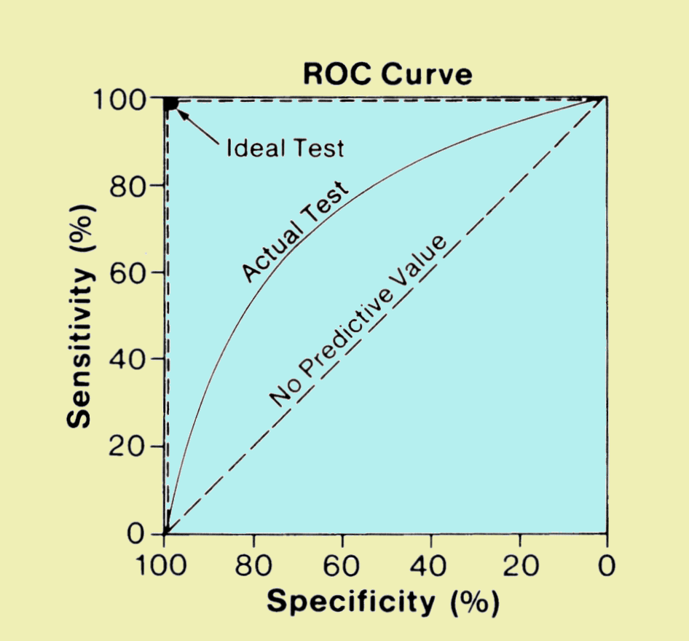
Evaluating LDA: supervised
Another more powerful approach would be that of the Receiving Operating Characteristic (ROC) curve.
The ROC curve illustrates the performance of a binary classifier as the discrimination threshold is varied.
In LDA we have to define a threshold. The ROC will show the performance of the model regardless of the threshold we select.

Slide 6
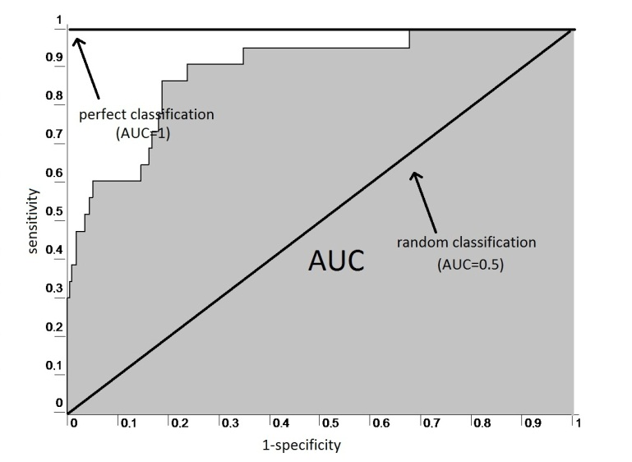
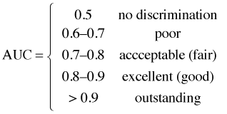
Evaluating LDA: supervised
A performance metric directly related to the ROC curve is the area under the curve (AUC).
Values close to 1 reflect good performance while values close to 0.5 mean that the model is no better than random chance.
A good characteristic of the AUC is that it is independent of the proportion of the classes. This makes it useful for unbalanced data sets.

Slide 7
Computing AUC in an efficient way
LDA provides a score. The scores can be ordered. Once ordered we have the rank of each instance.
If we know the ranks of the positive class (suspicious) which is the minority class (N1) then we know the rank of the negative class (N2>>N1). Sensitivity and specificity can now be computed.
We only need the rank of the N1 instances. AUC is computed summing the area of the rectangles.
Sensitivity will only change N1 times in the ROC. Specificity will decrease linearly N2 times

Slide 8
Datasets used for Proxy
“Normal” dataset
9,067,164 total number of records corresponding to y=2015, m=03 and d=01.
The assumption is that all this data is “normal” (might not be true)
“Abnormal” dataset
105 total number of unique attacks (not replicated)
EK_MALWARE malspam-amil
BIN_DNSWATCH
BIN_Mediana
RTF Mongall Dropper
APT ZEUS
Cryptolocker ….. And others

Slide 9
Results

Slide 10
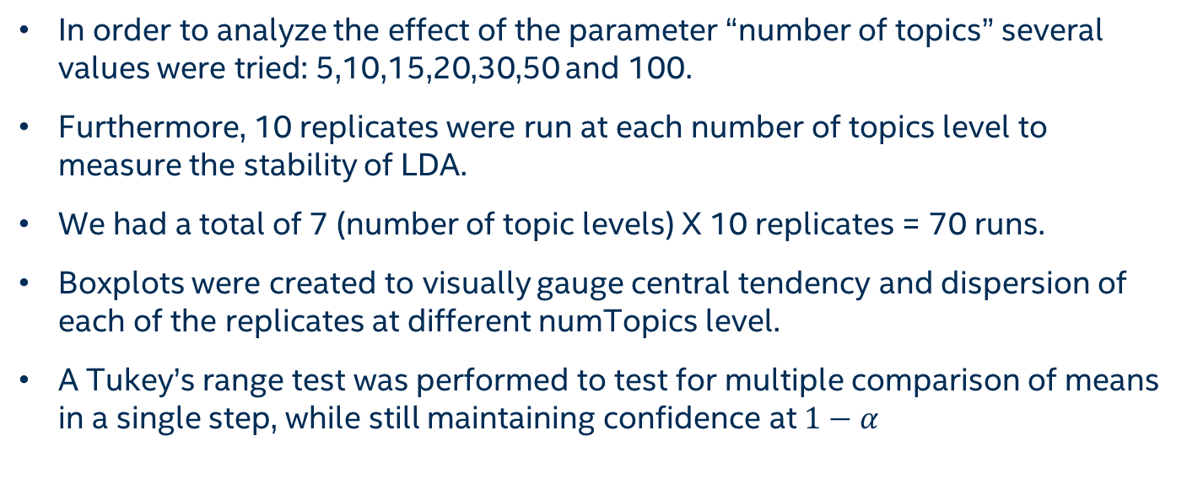
Results
In order to analyze the effect of the parameter “number of topics” several values were tried: 5,10,15,20,30,50 and 100.
Furthermore, 10 replicates were run at each number of topics level to measure the stability of LDA.
We had a total of 7 (number of topic levels) X 10 replicates = 70 runs.
Boxplots were created to visually gauge central tendency and dispersion of each of the replicates at different numTopics level.
A Tukey’s range test was performed to test for multiple comparison of means in a single step, while still maintaining confidence at $1−α$

Slide 11
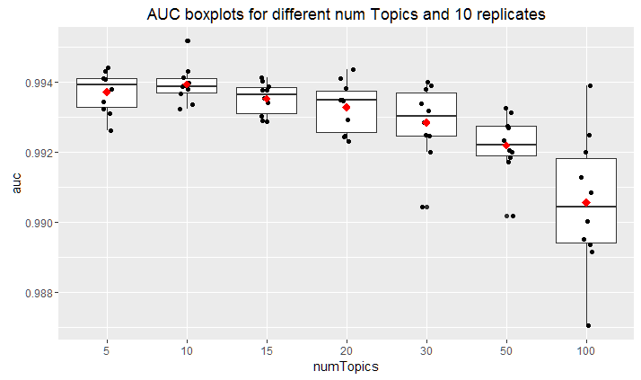
Boxplots
We can see central tendency as well as the dispersion for each of the replicates.
numTopics= 10 seems to be the best option in terms of stability and central tendency.
Performance starts to become unstable as the number of topics exceeds 20.
numTopics = 100 has larger variability and smaller mean.

Slide 12
ANOVA
ANOVA shows that the “number of topics” parameter is significant. This implies that at least one pair comparison is significantly different.
Df Sum Sq Mean Sq F value Pr(>F)
numTopics 6 8.280e-05 1.380e-05 13.36 1.06e-09 ***
Residuals 63 6.508e-05 1.033e-06
We then apply Tukey’s test to find which levels are different from each other.

Slide 13
Tukey’s test
Tukey multiple comparisons of means
95% family-wise confidence level
factor levels have been ordered
Fit: aov(formula = auc ~ numTopics, data = aucDF_master)
$numTopics
diff lwr upr p adj
50-100 0.0016385198 0.0002541970 0.003022843 0.0104917
30-100 0.0022920062 0.0009076834 0.003676329 0.0000820
20-100 0.0027285249 0.0013442021 0.004112848 0.0000021
15-100 0.0029713835 0.0015870606 0.004355706 0.0000003
5-100 0.0031611321 0.0017768093 0.004545455 0.0000000
10-100 0.0033850629 0.0020007401 0.004769386 0.0000000
30-50 0.0006534864 -0.0007308364 0.002037809 0.7793321
20-50 0.0010900051 -0.0002943177 0.002474328 0.2166410
15-50 0.0013328637 -0.0000514592 0.002717187 0.0665202
5-50 0.0015226123 0.0001382894 0.002906935 0.0220162
10-50 0.0017465431 0.0003622203 0.003130866 0.0050579
20-30 0.0004365187 -0.0009478042 0.001820842 0.9605448
15-30 0.0006793772 -0.0007049456 0.002063700 0.7468716
5-30 0.0008691259 -0.0005151970 0.002253449 0.4801835
10-30 0.0010930567 -0.0002912662 0.002477380 0.2138491
15-20 0.0002428586 -0.0011414643 0.001627181 0.9982134
5-20 0.0004326072 -0.0009517157 0.001816930 0.9622202
10-20 0.0006565380 -0.0007277849 0.002040861 0.7756009
5-15 0.0001897486 -0.0011945742 0.001574071 0.9995612
10-15 0.0004136795 -0.0009706434 0.001798002 0.9696258
10-5 0.0002239308 -0.0011603920 0.001608254 0.9988693
Tukey’s test allows us to see which pairs are different.
We can see that the level numTopics = 100 is significantly different from the rest.
The pairs 10-50 and 5-50 are also significantly different.
The rest of the comparisons don’t show significantly differences.

Slide 14
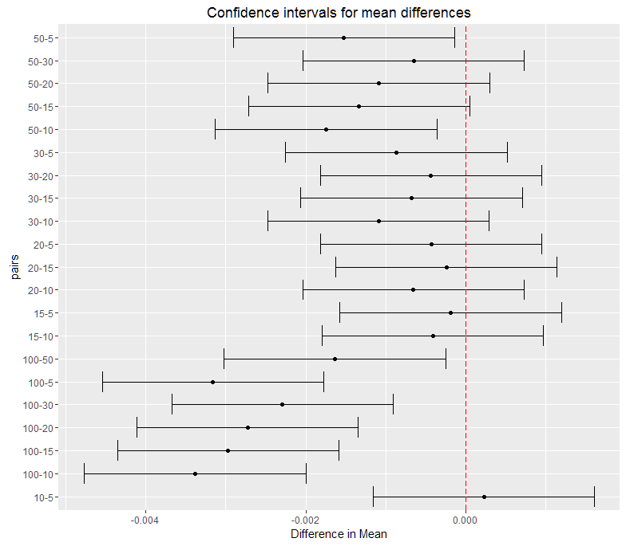
Tukey’s test
The next plot shows the confidence interval for mean differences for each of the pair combinations.
This plot shows exactly the same information as the previous table only on a visual representation.
Intervals which cross zero (red line) are not significant.
Test for significant difference is important because of time performance. If there is no difference in AUC between (x,y) pairs where (x<y), we might as well run numTopics=x because it will be faster.

Slide 15
Results for only one replicate and numTopics=20

Slide 16
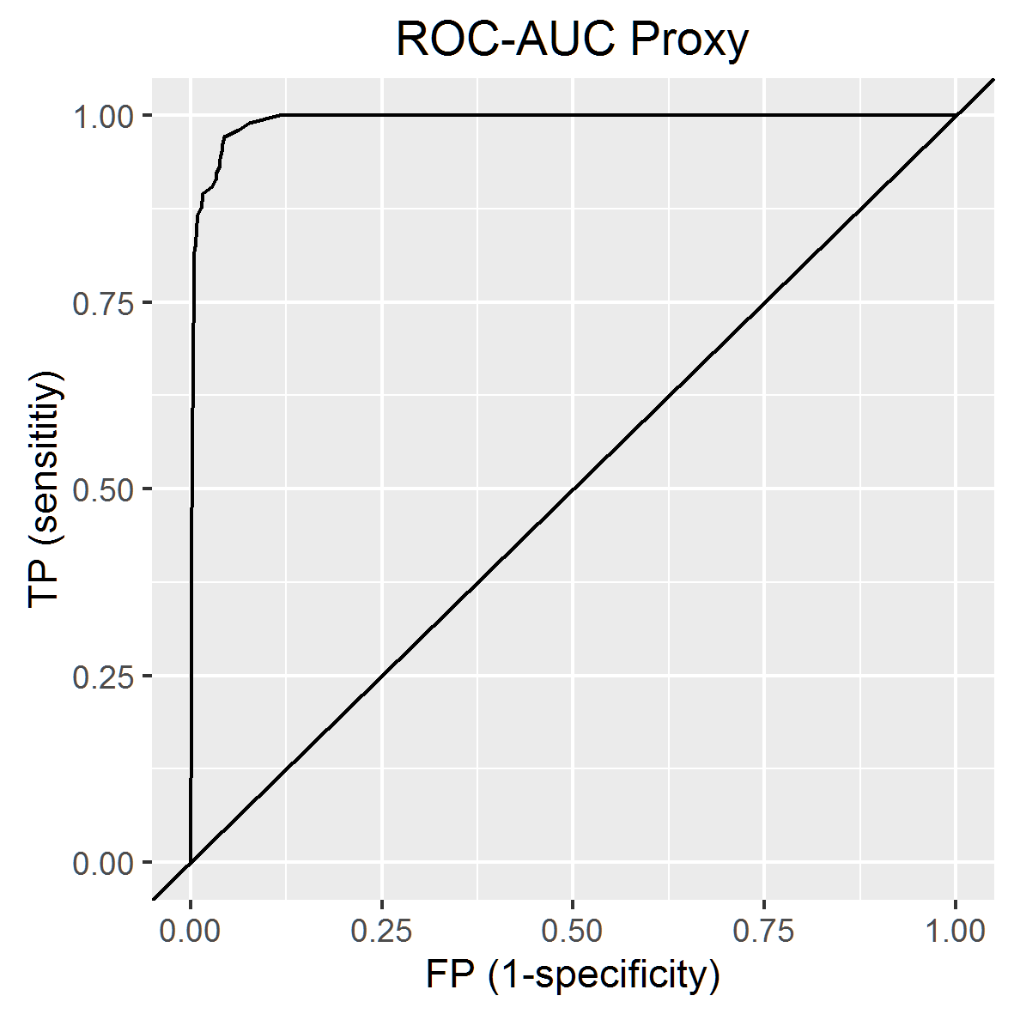
Results
From a theoretical point of view LDA provides an impressive performance in terms of ROC-AUC = 0.9923
This means that regardless of the threshold chosen it provides overall good balance of TP and FP.
From a practical point of view the massive amount of “good” data still makes the security analyst go through a lot of false positives. (or maybe not, remember we are assuming that attacks not generated by us are “good”)
AUC = 0.9933

Slide 17
Results (the amount of chaff)
host | score | rank | label | ID | TP | FP
0 | 0 | 0 | null | 0 | 0 | 0
vcvcvcvc.dyndns.org | 4.44E-07 | 89 | bad | 1 | 0.009524 | 9.48E-06
vcvcvcvc.dyndns.org | 4.44E-07 | 90 | bad | 2 | 0.019048 | 9.48E-06
vcvcvcvc.dyndns.org | 4.44E-07 | 91 | bad | 3 | 0.028571 | 9.48E-06
www.dnswatch.info | 4.58E-07 | 98 | bad | 4 | 0.038095 | 1.01E-05
trapbath.ru | 7.68E-07 | 551 | bad | 5 | 0.047619 | 6.00E-05
trapbath.ru | 7.68E-07 | 552 | bad | 6 | 0.057143 | 6.00E-05
trapbath.ru | 1.29E-06 | 2241 | bad | 7 | 0.066667 | 0.000246
trapbath.ru | 1.29E-06 | 2242 | bad | 8 | 0.07619 | 0.000246
trapbath.ru | 1.54E-06 | 3142 | bad | 9 | 0.085714 | 0.000345
trapbath.ru | 1.54E-06 | 3143 | bad | 10 | 0.095238 | 0.000345
61.178.77.169 | 2.12E-06 | 5661 | bad | 11 | 0.104762 | 0.000623
61.178.77.170 | 2.12E-06 | 5662 | bad | 12 | 0.114286 | 0.000623
61.178.77.169 | 2.41E-06 | 6790 | bad | 13 | 0.12381 | 0.000747
146.185.213.35 | 2.47E-06 | 7007 | bad | 14 | 0.133333 | 0.000771
vcvcvcvc.dyndns.org | 3.15E-06 | 9790 | bad | 15 | 0.142857 | 0.001078
….. | …. | …. | …. | …. | …. | ….
The amount of “chaff” can be seen in the following table.
By looking at the rank of the “bad” instances we know what threshold we are willing to accept and the TP and FP associated with it.
For example, if our threshold is 2242 then we will find 8 “bad” instances and 2242-8 = 2234 “good” instances.
The table is truncated. TP and FP columns are the ones used to plot ROC.

Slide 18
Results (types of attacks)
rank | id | Type of attack
89 | 1 | BIN_DNSWATCH
90 | 2 | BIN_DNSWATCH
91 | 3 | BIN_DNSWATCH
98 | 4 | BIN_DNSWATCH
551 | 5 | APT ZEUS
552 | 6 | APT ZEUS
2241 | 7 | APT ZEUS
2242 | 8 | APT ZEUS
3142 | 9 | APT ZEUS
3143 | 10 | APT ZEUS
… | … | …
296185 | 96 | BIN_Mediana
307252 | 97 | BIN_Mediana
348334 | 98 | No name
349569 | 99 | APT ZEUS
366444 | 100 | No name
374053 | 101 | APT ZEUS
394876 | 102 | BIN_Mediana
573898 | 103 | BIN_Mediana
693769 | 104 | BIN_Mediana
1053390 | 105 | BIN_Mediana
BIN_DNSWATCH was the type of attack with the lowest rank (89-98), easiest to detect.
APT ZEUS was the second lowest ranked type of attack (551-3143).
At the bottom of the list we have again some types of APT ZEUS attacks that were difficult to identify (349569, 374053).
At the bottom we have BIN_Mediana as the type of attack most difficult to detect in this specific dataset.
The table is truncated. A separate file is provided with all the attacks.

Slide 19
Next steps
Investigate why the AUC is unusually high.
Create a repository of attacks we can re-use.
Repeat procedure using other normal dataset (other day worth of data).
Repeat procedure for Netflow and DNS.
Discuss with team additional performance metrics. (See next slide).
Tune LDA or create new features to improve this performance.

Slide 20
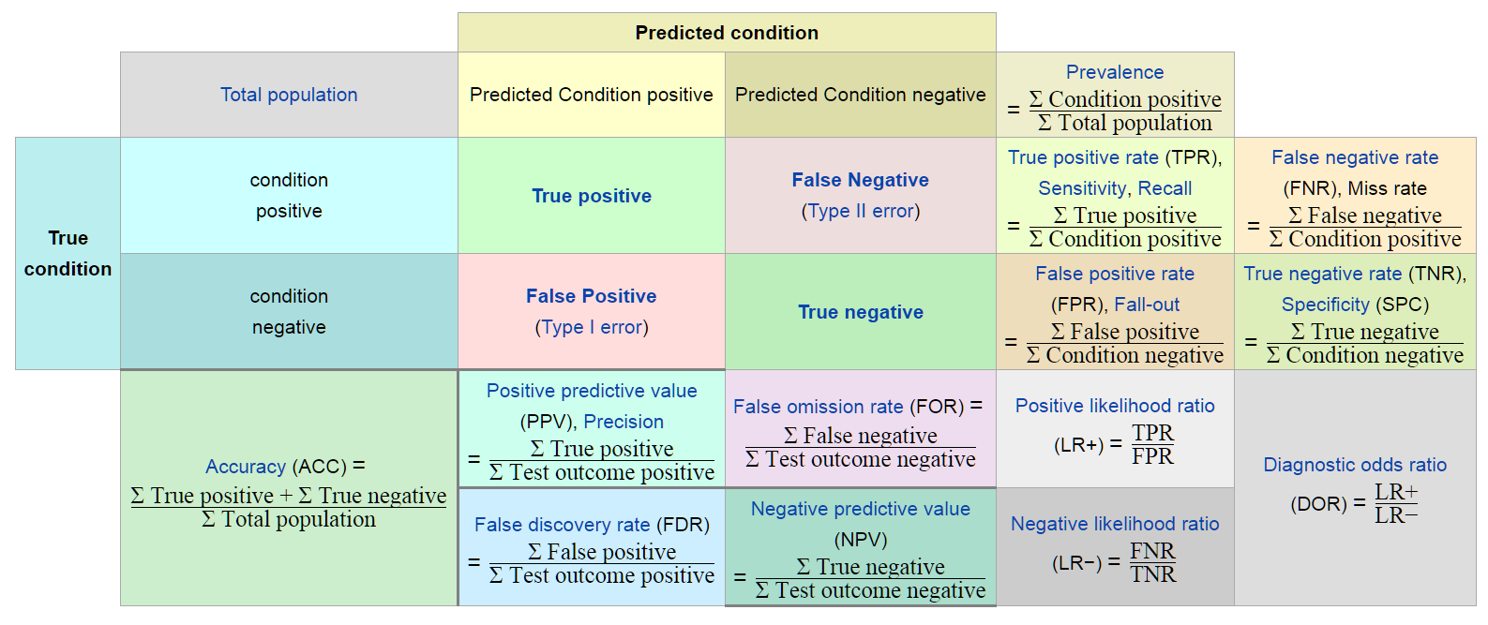
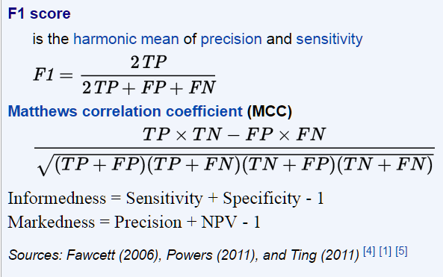
Additional performance metrics
https://en.wikipedia.org/wiki/Precision_and_recall

